Slide 1
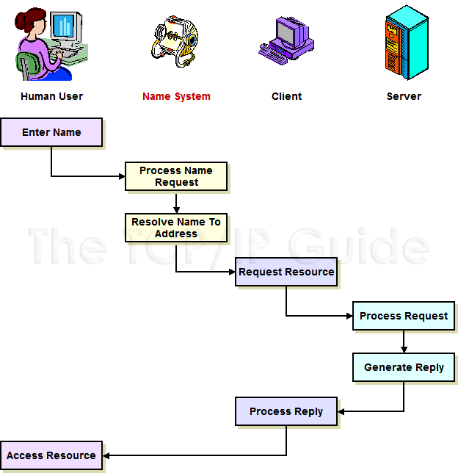
Internetwork Access With A Name System

Slide 2
Internetwork Access With A Name System
When an internetwork is equipped with a name system, the user no longer needs to know the address of a device to access it. He or she enters the name and the name system converts it into an address automatically, like a computerized “rolodex”, as I have shown here. The name system then passes the address to the client software which uses that address to access the requested resource as if the user had entered it directly.

Slide 3
Networking name systems
Key Concept: Networking name systems are important because they allow devices to be assigned efficient numeric addresses, while still enabling humans to access them using names that are easier to remember. Name systems become more important as you increase the size of the network, the address or the user base. They are also more essential when the user base is limited in skill or experience.

Slide 4
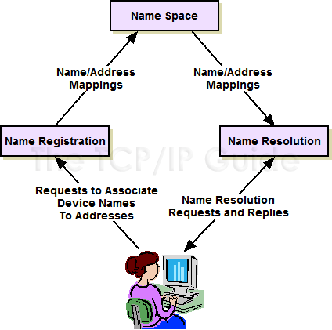
Name System Functions

Slide 5
Name System Functions
This diagram shows the relationships between the three main functions of a name system. The name space defines the structure of the name system and the rules for creating names. The name space is used as the basis for the name registration method, which defines the mappings between names and addresses.When a user wants to access a device by name, a name resolution method is used to consult the name space, determine what address is associated with a name, and then convert the name to an address.

Slide 6
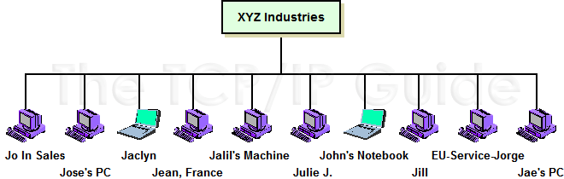
Flat Name Architecture (Flat Name Space)

Slide 7
Flat Name Architecture (Flat Name Space)
This diagram shows an example of a flat name architecture. There is no structure that organizes the names or dictates how they must be constructed. Logically, each device is a peer of each of the others.

Slide 8
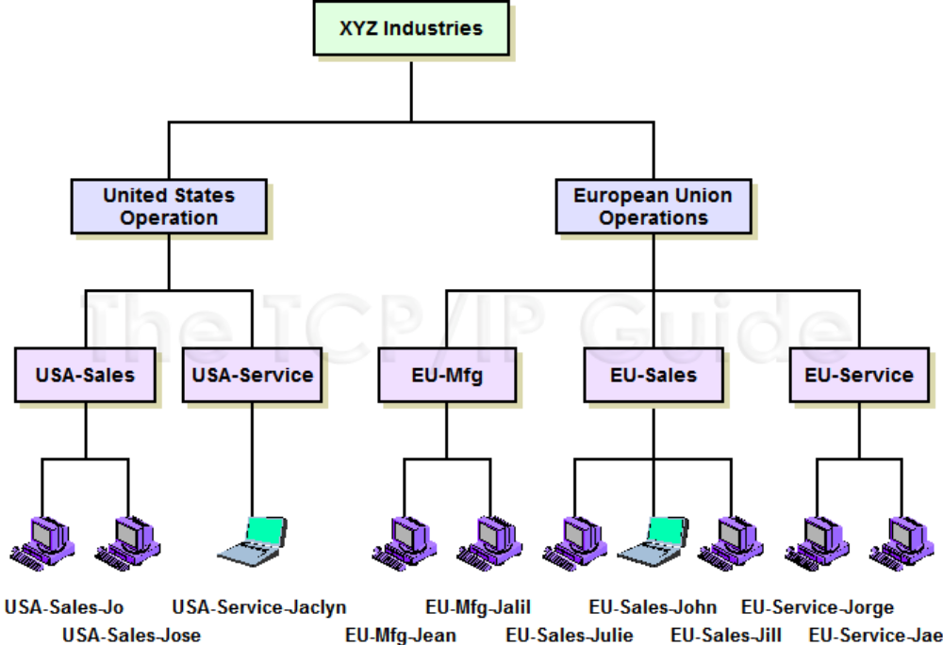
Hierarchical Name Architecture (Structured Name Space)

Slide 9
Hierarchical Name Architecture (Structured Name Space)
This diagram contains the same devices, but they have been arrangedusing a hierarchical, structured name architecture. In this case, the organization haschosen to structure its device names first by facility location, and then by department. Each name starts with something like “USA-Service-” or “EU-Mfg-”. This provides immediate benefits by providing local control over device naming without risk of conflicts. If someone named John were hired into the USA sales force, his machine could be named “US-Sales-John” without conflicting with the machine owned by John of the European sales force (“EU-Sales-John”.) The structure also makes it easier to know immediately where a device can be found within the organization.

Slide 10
Name architecture
Key Concept: The two most common types of name architecture are the flat name space and the hierarchical name space. Names in a flat name space are all peers with no relationship; in a hierarchical architecture, a multi-level structure is used to organize names in a specific way. The flat system is simpler and satisfactory for small networks, while the hierarchical name space is more flexible and powerful, and better-suited to larger networks and internetworks.

Slide 11
Name registration
Key Concept: Name registration is the process by which names are linked to addresses in a name system. It encompasses activities such as central registry authority designation and delegation, and name space structure management. The most common methods of name registration, in order of both increasing capability and complexity, are manual table maintenance, broadcast registration and database registration.

Slide 12
Name resolution
Key Concept: Name resolution is arguably the most important of the main functional elements of a name system, because it is the part of the system that actually converts names into addresses. The two main components of name resolution are name resolvers, which act as clients in the resolution process, and name servers. The three main name resolution methods—table-based, broadcast and client/server—correspond closely to the table, broadcast and database methods of name registration.

Slide 13
Name resolution
Key Concept: Since name resolution is the part of a name system that is used most often, it is here that we must pay careful attention to implementation issues. The two most important ones are efficiency and reliability. Efficiency is essential due to the many thousands or millions of resolutions performed every day on a large system; reliability is a consideration because users of the name system quickly come to rely on it and we must make sure it is robust.

Slide 14
Example TCP/IP Host Table
# Host Database # This file should contain the addresses and aliases # for local hosts that share this file. # # Each line should take the form: # <address> <host name> # 127.0.0.1 localhost 209.68.14.80 www.pcguide.com 216.92.177.143 www.desktopscenes.com 198.175.98.64 ftp.intel.com

Slide 15
Host table name system
Key Concept: The host table name system was the original mechanism used for implementing names on the early Internet. It consists simply of a set of tables containing mappings between names and addresses maintained on each machine in the internetwork. When a name needs to be resolved the table is consulted to determine the appropriate address. This system is extremely simple, but not very capable, and not well-suited to a large global Internet, which is why it was eventually abandoned in favor of DNS.

Slide 16
TCP/IP naming
Key Concept: Even though the host table name system is not the primary mechanism used for TCP/IP naming, it still used in two circumstances. The first is to implement a basic name system in a small local TCP/IP internetwork.The second is as an adjunct to DNS, where it allows manual mappings to be created that override the DNS process when needed.

Slide 17
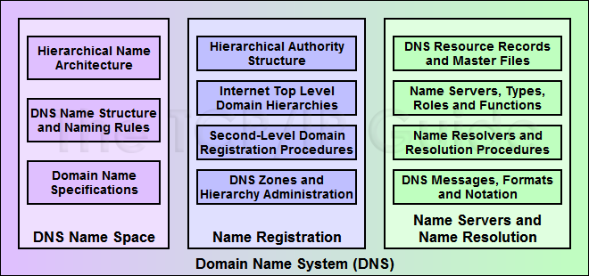
DNS Functions

Slide 18
DNS
Key Concept: As a complete name system, DNS provides numerous capabilities that implement each of the three basic name system functions. The DNS name space is hierarchical and is organization using a multi-level structure with particular naming rules. The DNS name registration system is based on the idea of a hierarchy of domains and registration authorities responsible for them. DNS name resolution is similarly hierarchical, and designed around interaction between name resolver and name server software components that consult databases of DNS resource records and communicate using a special messaging protocol to answer client queries.

Slide 19
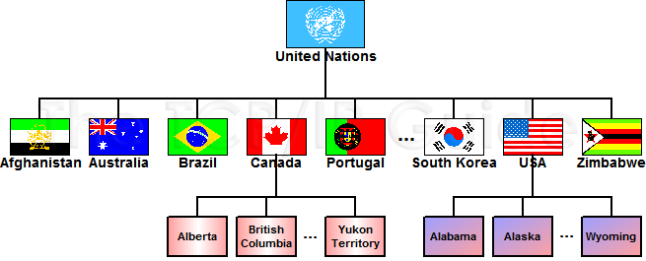
Example of a Global Hierarchical Domain Architecture

Slide 20
Example of a Global Hierarchical Domain Architecture
This diagram shows an example of hierarchical architecture, based on political divisions. The United Nations is an umbrella organization representing (to one extent or another) all of the world’s nations. It is the root of the tree; underneath it we find individual nations. Each nation then is further subdivided in a manner it chooses; for example, Canada has provinces and territories, and the USA individual states. These can in turn be further subdivided in any number of ways.

Slide 21
Hierarchy of domains
Key Concept: The DNS name space is arranged into a hierarchy of domains shaped like an inverted tree. It is structurally similar to the directory structure of a file system, with a root that contains domains, each of which can contain subdomains and so forth.

Slide 22
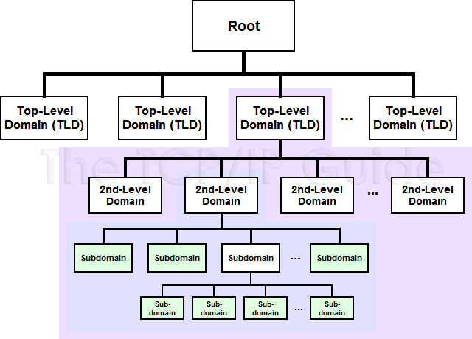
DNS Name Space Tree and Domain-Related Terminology

Slide 23
DNS Name Space Tree and Domain-Related Terminology
Key Concept: The top of the DNS name space is the root; under the root come top-level domains, and within these are second-level domains and then subdomains. In theory, any number of levels of subdomains can be created. A branch is any contiguous portion of the DNS tree; a leaf is a domain with nothing underneath it in the structure, and usually represents a single device.

Slide 24
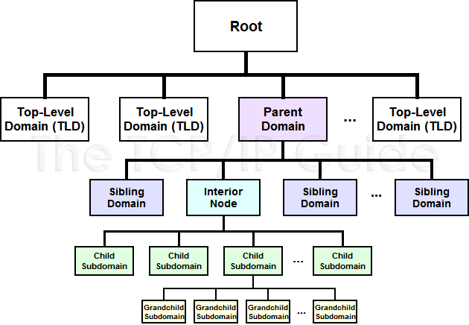
DNS Name Space “Family Tree”

Slide 25
DNS Name Space “Family Tree”
I have labeled the nodes differently to show the “family-oriented” terminology sometimes used in DNS. In this case, the names are relative to the interior node shown in cyan. The domain immediately above it is its parent node; other nodes on the same level are siblings, and subdomains within it are children of that node.

Slide 26
Parent domain
Key Concept: The domain above a given domain in the DNS name space is called its parent domain; domains at the same level within the same parent are siblings; and subdomains are called children of that domain.

Slide 27
Label
Key Concept: Each node in the DNS name space is identified by a label. Each label must be unique within a parent domain, but need not be unique across domains. This enables each domain to have local control over the names of subdomains without causing any conflict in the full domain names created on a global level.

Slide 28
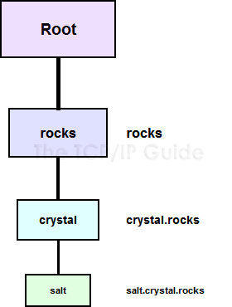
DNS Labels and Domain Name Construction

Slide 29
DNS Labels and Domain Name Construction
Each node in the DNS name space has a label (except the root, whose label is null). The domain name for a node is constructed simply by placing in order the sequence of labels from the top of the tree down to the individual domain, going from right to left, separating each label with a dot (period).

Slide 30
DNS Labels and Domain Name Construction
Key Concept: A domain name is a string of text that uniquely identifies a particular node in the name space. The domain name for a node is constructed by concatenating in right-to-left order all the labels in the branch of the DNS tree starting from the top of the tree down to the particular node, separating each by a dot (period.)

Slide 31
FQDN - PQDN
Key Concept: A fully-qualified domain name (FQDN) is a complete domain name that uniquely identifies a node in the DNS name space by giving the full path of labels from the root of the tree down to that node. It defines the absolute location of a domain. In contrast, a partially-qualified domain name (PQDN) only specifies a portion of a domain name. It is a relative name that has meaning only within a particular context; the partial name must be interpreted within that context to fully identify the node.

Slide 32
Hierarchy of authorities
Key Concept: The name space of the public Internet is managed by a hierarchy of authorities that is similar in structure to the hierarchical DNS name space, though not identical. The top of the hierarchy is centrally managed by IANA/ICANN, which delegates authority to other organizations for registering names in various other parts of the hierarchy. The information about name registrations is maintained in resource records stored in various locations, which form a distributed name database on the Internet.

Slide 33
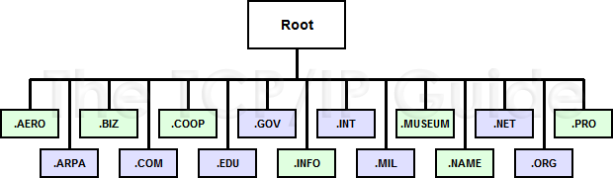
Internet DNS Organizational (Generic) Top-Level Domains (TLDs)

Slide 34
Top-level domains
Key Concept: One of the two ways in which the Internet’s DNS name space is divided is using a set of generic top-level domains. These TLDs are intended to provide a place for all companies and organizations to be named based on their organization type. There were originally six such domains, but this has been expanded so that there are now fifteen.

Slide 35
Country code top-level domains
Key Concept: Due to the limitations of the generic TLDs, a set of country code top-level domains was created. This geopolitical hierarchy allows each nation on earth to set up its own name system based on its own requirements, and to administer it in the manner it sees fit. The IANA determines what is a country based on official decisions made by ISO.

Slide 36
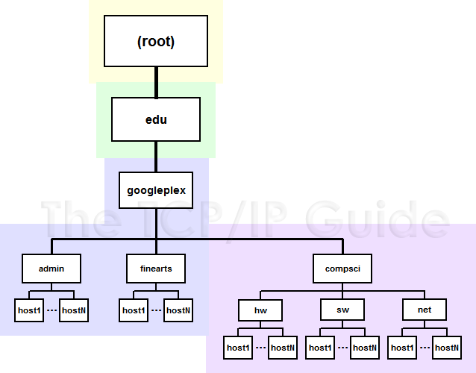
DNS Zones Of Authority

Slide 37
DNS Zones Of Authority
This example shows how cuts can be made between nodes in the DNS name tree to create an arbitrary hierarchy of name authorities. In this example I have shown the DNS tree branch for “googleplex.edu”, with each zone indicated using a different background color. IANA/ICANN is responsible for the root domain (yellow), and a separate authority named Educause takes care of “.EDU” (green). The blue zone covers much of “googleplex.edu”, except that a cut has been made between “googleplex” and “compsci” to create an independent zone of authority for “compsci.googleplex.edu”, shown in purple.

Slide 38
Zones of authority
Key Concept: The DNS name registration hierarchy is divided into regions called zones of authority. Each zone represents an area that is administered independently, and consists of a contiguous segment of the DNS name tree.

Slide 39
Domain name
Key Concept: Once an organization registers a particular domain name, it becomes the owner of that name and can decide whether and how to create a substructure within that domain. If it wants objects in the domain to be accessible on the public Internet, it must structure its domain to be consistent with Internet DNS standards. Alternately, it can create a purely private domain using any structure and rules it prefers.

Slide 40
Authoritative name servers
Key Concept: DNS public name information is stored in a distributed database of DNS name servers that are structured in a hierarchy comparable to the hierarchy of authorities. Each zone has one or more DNS name servers in charge of the zone’s information, called authoritative name servers.

Slide 41
Authoritative name servers
Key Concept: The DNS name server hierarchy is logical in nature and not exactly the same as the DNS name server tree. One server may be responsible for many domains and subdomains. Also, the structure of the DNS name server hierarchy doesn’t necessarily indicate the physical locations of name servers.

Slide 42
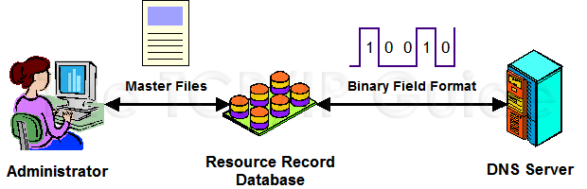
DNS Resource Record Master File and Binary Field Formats

Slide 43
DNS Resource Record Master File and Binary Field Formats
To meet the needs of humans and computers, DNS uses two representations for the data stored in resource records. Administrators enter and maintain information in textual DNS master files. These are read by DNS server software and internally stored in binary format for answering DNS requests.

Slide 44
Resource records
Key Concept: DNS name servers store DNS information in the form of resource records (RRs). Each RR contains a particular type of information about a node in the DNS tree. There are two representations for resource records: conventional binary field formats are used for communication between DNS name servers and resolvers, while text master files are edited by administrators to manage DNS zones.

Slide 45
Summary Of Common DNS Resource Records
RR Type Value | RR Text Code | RR Type | Description
1 | A | Address | Contains a 32-bit IP address. This is the “meat and potatoes” of DNS, since it is where the address of a node is stored for name resolution purposes.
2 | NS | Name Server | Specifies the name of a DNS name server that is authoritative for the zone. Each zone must have at least one NS record that points to its primary name server, and that name must also have a valid A (Address) record.
5 | CNAME | Canonical Name | This resource record is used to allow aliases to be defined that point to the real name of a node. The CNAME record provides a mapping between this alias and the “canonical” (real) name of the node. The CNAME resource record is commonly used to hide changes in the internal DNS structure from outside users, by letting them use an unchanging alias while the internal names are modified based on the needs of the organization. See the topic on name resolution for an example.

Slide 46
Summary Of Common DNS Resource Records
6 | SOA | Start Of Authority | The SOA resource record is used to mark the start of a DNS zone and provide important information about it. Every zone must have exactly one SOA record, which contains details such as the name of the zone, its primary (master) authoritative server name, and technical details such as the e-mail address of its administrator and parameters for how often slave (secondary) name servers are updated.
12 | PTR | Pointer | Provides a pointer to another location in the name space. These records are best known for their use in reverse resolution through the IN-ADDR.ARPA domain.
15 | MX | Mail Exchange | Specifies the location (device name) that is responsible for handling e-mail sent to the domain.
16 | TXT | Text String | Allows arbitrary additional text associated with the domain to be stored.

Slide 47
DNS
Key Concept: The DNS standards were originally created to allow them to work with multiple protocols, by specifying the class of each resource record. Today the only class commonly used is that for TCP/IP, which is called “IN” (for “Internet”).

Slide 48
Primary / Secondary DNS Server
Key Concept: The master DNS server for a zone is its primary server, which maintains the master copy of DNS information. Most DNS zones also have at least one slave or secondary DNS server. These are important because they serve as backups for the primary server, and they can also help share the load of responding to requests in busy zones. Secondary name servers get their information from primary servers on a routine basis. Both master and slave servers are considered authoritative for the zones whose data they maintain.

Slide 49
Caching-only name servers
Key Concept: There are DNS servers that do not maintain DNS resource records of their own but solely hold recently-used information from other zones. These are called caching-only name servers and are not authoritative for any zone.

Slide 50
Contact names
Key Concept: Each DNS domain has associated with it a set of three contact names that indicate who is responsible for managing it. The administrative contact is the person with overall responsibility for the domain. The billing contact is responsible for payment issues; this may be the same as the administrative contact. The technical contact is in charge of technical matters for the domain, and is often a different person than the administrative contact, especially when DNS services are out-sourced.

Slide 51
Zone transfer
Key Concept: Slave name servers do not have their DNS information managed directly by an administrator. Instead, they obtain information from their master name server on a periodic basis through a process called a zone transfer. Several fields in the Start Of Authority DNS resource record control the zone transfer process, including specifying how often transfers are done and how slave name servers handle problem conditions such as an inability to contact the master server.

Slide 52
DNS Root Name Servers
Key Concept: Information about the DNS root and its top-level domains is managed by a set of root name servers. These servers are essential to the operation of DNS; they are arranged into thirteen groups and physically distributed around the world.

Slide 53
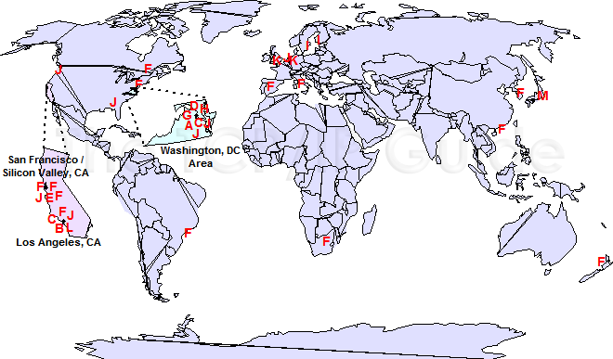
DNS Root Name Servers

Slide 54
DNS Root Name Servers
On The Web: The current list of root name servers can be found in the file ftp://ftp.rs.internic.net/domain/named.root
You can also find the information in a more user-friendly format at http://www.root-servers.org

Slide 55
Name Server Caching
Key Concept: Caching is an essential efficiency feature that reduces DNS message traffic by eliminating unnecessary requests for recently-resolved names. Whenever a name is resolved the resulting DNS information is cached so it can be used for subsequent requests that occur shortly thereafter.

Slide 56
Name Server Caching
Key Concept: Cached information can become stale over time, and result in incorrect responses sent to queries. Each resource record can have associated with it a time interval, called the Time To Live (TTL), that specifies how long the record may be held in a cache. The value of this field is controlled by the owner of the resource record, who can tailor it to the specific needs of each resource record type.

Slide 57
DNS Name Server Load Balancing
Key Concept: Rather than creating a single Address resource record for a DNS domain name, it is possible to create multiple. This associates several IP addresses with one name, which can be used to spread a large number of access to one domain name over many physical IP devices. This allows DNS to implement load balancing for busy Internet servers.

Slide 58
DNS Notify
Key Concept: The optional DNS Notify feature allows a master name server to inform slave name servers when changes are made to a zone. This has two advantages: it cuts down on unnecessary polling by the slave servers to find out if changes have occurred to DNS information, and it also reduces the amount of time that slave name servers have out-of-date records.

Slide 59
Incremental Zone Transfer
Key Concept: The DNS incremental zone transfer enhancement uses a special message type that allows a slave name server to determine what changes have occurred since it last synchronized with the master server. By transferring only the changes, the amount of time and bandwidth used for zone transfers can be significantly reduced.

Slide 60
DNS Update / Dynamic DNS
Key Concept: An enhancement to DNS, commonly called dynamic DNS, allows DNS information in a server’s database to be updated automatically, rather than always requiring hand-editing of master files. This can not only save time and energy on the part of administrators, it allows DNS to better handle dynamic address assignment, such as the type performed by host configuration protocols such as DHCP.

Slide 61
DNS Name Resolver
Key Concept: The primary clients in DNS are software modules called DNS name resolvers. They are responsible for accepting names from client software, generating resolution requests to DNS servers, and processing and returning responses.

Slide 62
DNS Name Resolution
Key Concept: Since DNS name information is stored as a distributed database spread across many servers, name resolution cannot usually be performed using a single request/response communication. It is first necessary to find the correct server that has the information that the resolver requires. This usually requires a sequence of message exchanges, starting from a root name server and proceeding down to the specific server containing the resource records that the client requires.

Slide 63
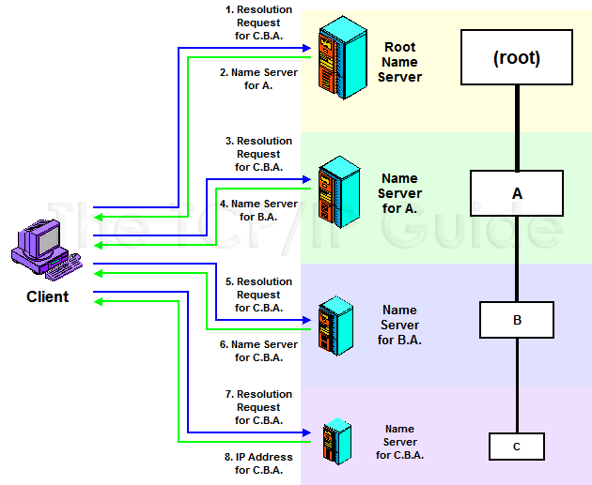
Iterative DNS Name Resolution

Slide 64
Iterative DNS Name Resolution
In this example, the client is performing a name resolution for “C.B.A.” using strictly iterative resolution. It is thus responsible for forming all DNS requests and processing all replies. It starts by sending a request to the root name server for this mythical hierarchy. That server doesn’t have the address of “C.B.A.”, so it instead returns the address of the name server for “A.”. The client then sends its query to that name server, which points the client to the server for “B.A.”. That name server refers the client to the name server that actually has the address for “C.B.A.”, which returns it to the client.

Slide 65
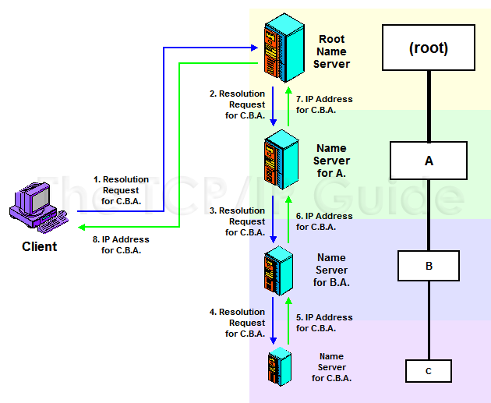
Recursive DNS Name Resolution

Slide 66
Recursive DNS Name Resolution
This time, the client asks for the name servers to perform recursive resolution and they agree to do so. As in the iterative case, the client sends its initial request to the root name server. That server doesn’t have the address of “C.B.A.”, but instead of merely returning to the client the address of the name server for “A.”, it sends a request to that server itself. That name server sends a request to the server for “B.A.”, which in turn sends a request to the server for “C.B.A.”. The address of “C.B.A.” is then carried back up the chain of requests, from the server of “C.B.A.” to that of “B.A.”, then “A.”, then the root, and then finally, back to the client.

Slide 67
DNS Name Resolution
Key Concept: The two methods of name resolution in DNS are iterative resolution and recursive resolution. In iterative resolution, if a client sends a request to a name server that does not have the information the client needs, the server returns a pointer to a different name server and the client sends a new request to that server. In recursive resolution, if a client sends a request to a server that doesn’t have the requested information, that server takes on the responsibility for sending requests to other servers to find the necessary records, then returns them to the client. A server doing this takes on the role of client for its requests to other servers.

Slide 68
Name Resolver Caching
Key Concept: In addition to the caching performed by DNS name servers, many (but not all) DNS resolvers also cache the results of recent resolution requests. This cache is checked prior to beginning a name resolution, to save time when multiple requests are made for the same name.

Slide 69
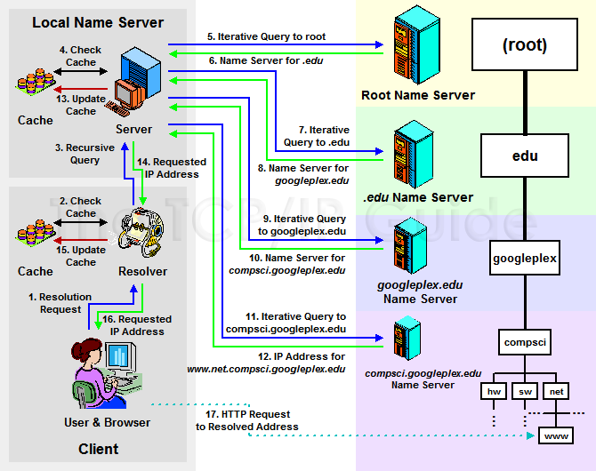
Example Of The DNS Name Resolution Process

Slide 70
Example Of The DNS Name Resolution Process
This fairly complex example illustrates a typical DNS name resolution using both iterative and recursive resolution. The user types in a DNS name (“www.net.compsci.googleplex.edu”) into a Web browser, which causes a DNS resolution request to be made from her client machine’s resolver to a local DNS name server. That name server agrees to resolve the name recursively on behalf of the resolver, but uses iterative requests to accomplish it. These requests are sent to a DNS root name server, followed in turn by the name servers for “.edu”, “googleplex.edu” and ‘compsci.googleplex.edu”. The IP address is then passed to the local name server and then back to the user’s resolver and finally, her Web browser software.

Slide 71
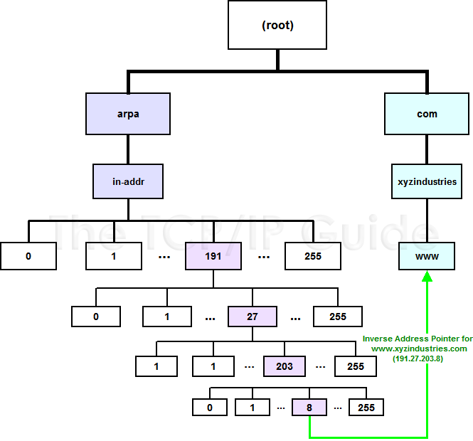
The DNS IN-ADDR.ARPA Reverse Name Resolution Hierarchy

Slide 72
The DNS IN-ADDR.ARPA Reverse Name Resolution Hierarchy
The special “IN-ADDR.ARPA” hierarchy was created to allow easy reverse lookups of DNS names. “IN-ADDR.ARPA” contains 256 subdomains numbered 0 to 255, each of which has 256 subdomains numbered 0 to 255, and so forth, down four levels. Thus, each IP address is represented in the hierarchy. In this diagram I have shown as an example the DNS domain name “www.xyzindustries.com”. It would have a conventional resource record pointing to its IP address, 191.27.203.8, as well as a reverse resolution record at 8.203.27.191.IN-ADDR.ARPA, pointing to the domain name “www.xyzindustries.com”.

Slide 73
Reverse Name Resolution
Key Concept: Most name resolutions require that we transform a DNS domain name into an IP address. However, there are cases where we want to perform a reverse name resolution, by starting with an IP address and finding out what domain name matches it. This is difficult to do using the conventional DNS distributed name hierarchy, because there is no easy way to find the DNS server containing the entries for a particular IP address using the regular DNS name hierarchy. To this end, a special hierarchy called IN-ADDR.ARPA was set up for reverse name lookups. This hierarchy contains four levels of numerical subdomains structured so that each IP address has its own node. The node for an IP address contains an entry that points to the DNS domain name associated with that address.

Slide 74
DNS Electronic Mail Support and Mail Exchange (MX) Resource Records
Key Concept: Since electronic mail is sent using host names and not IP addresses, DNS contains special provisions to support the transfer of e-mail between sites. Special mail exchange (MX) DNS resource records are set up that contain the names of mail servers that a domain wants to use for handling incoming e-mail. Before sending e-mail to a site, a device performs a name resolution to get that site’s MX record, so it knows where to send the message.

Slide 75
DNS Message Transport Using UDP and TCP
Key Concept: DNS uses both UDP and TCP to send messages. Conventional message exchanges are “short and sweet” and thus well-suited to the use of the very fast UDP; DNS itself handles the detection and retransmission of lost requests. For larger or more important exchanges of information, especially zone transfers, TCP is used—both for its reliability and its ability to handle messages of any size.

Slide 76
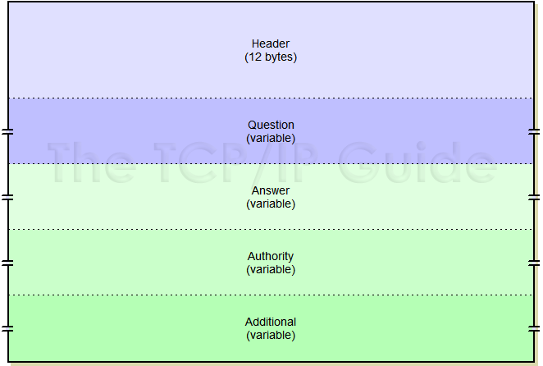
DNS General Message Format

Slide 77
DNS General Message Format
Key Concept: DNS uses a general message format for all messages. It consists of a fixed 12-byte Header, a Question section that contains a query, and then three additional sections that can carry resource records of different types. The Answer section usually contains records that directly answer the Question of the message; the Authority section holds the names of name servers being sent back to the client, and the Additional section holds extra information that may be of value to the client, such as the IP address of a name server mentioned in the Authority section.

Slide 78
Sample DNS Master File
$ORIGIN pcguide.com.
@ IN SOA ns23.pair.com. root.pair.com. (
2001072300 ; Serial
3600 ; Refresh
300 ; Retry
604800 ; Expire
3600 ) ; Minimum
@ IN NS ns23.pair.com.
@ IN NS ns0.ns0.com.
localhost IN A 127.0.0.1
@ IN A 209.68.14.80
IN MX 50 qs939.pair.com.
www IN CNAME @
ftp IN CNAME @
mail IN CNAME @
relay IN CNAME relay.pair.com.

Slide 79
DNS Changes To Support IP Version 6
Key Concept: Even though DNS resides far above the Internet Protocol in the TCP/IP protocol suite architecture, it works intimately with IP addresses. For this reason, changes are required to allow it to support the new IPv6. These changes include the definition of a new IPv6 address resource record (AAAA), a new reverse resolution domain hierarchy, and certain changes to how messaging is performed.

Slide 80
Referencia
The TCP/IP Guide
Charles M. Kozierok
  http://www.tcpipguide.com/

